Slide 1
Digital Portfolio
STUDENT NAME: R.K.AJEETHA
REGISTER NO AND NMID: 212400984/FA033CA12C6191584C74720DF6DD52D6
DEPARTMENT: BACHELOR OF COMPUTER APPLICATIONS
COLLEGE: PRINCE SHRI VENKATESHWARA ARTS AND SCIENCE COLLEGE/MADRAS UNIVERSITY

Slide 2
PROJECT TITLE
AJEETHA PORTFOLIO

Slide 3


AGENDA
Problem Statement
Project Overview
End Users
Tools and Technologies
Portfolio design and Layout
Features and Functionality
Results and Screenshots
Conclusion
Github Link
3/21/2024 Annual Review

Slide 4

PROBLEM STATEMENT
Students and professionals often face difficulties in presenting their skills, projects, and achievements in a structured and accessible way. Traditional resumes and paper portfolios fail to showcase practical work, coding projects, and real-time updates effectively. There is a lack of a centralized, interactive, and user-friendly platform where learners can highlight their competencies and employers can quickly evaluate their capabilities.

Slide 5
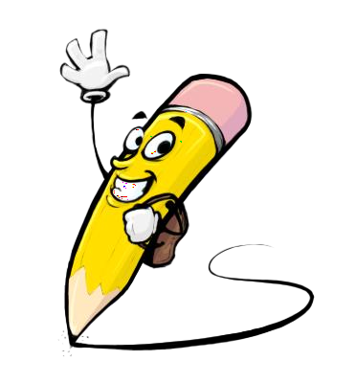
PROJECT OVERVIEW
The project aims to leverage technology and innovative solutions to address real-world challenges by integrating modern tools and skills. It provides an opportunity to apply the knowledge and training gained through the Naan Mudhalvan program into practical implementation. The focus is on building a solution that is user-friendly, scalable, and impactful

Slide 6

WHO ARE THE END USERS?
Students and graduates who wish to showcase their skills and achievements.Recruiters and employers seeking potential candidates.Academic institutions for evaluating student progress.Professionals looking for a structured way to present their portfolio.

Slide 7

TOOLS AND TECHNIQUES
Design Tools: Canva, Figma, Adobe XD (for portfolio design).Development Tools: HTML, CSS, JavaScript, Bootstrap (for web-based portfolio).Version Control: Git & GitHub (for code management).Presentation Tools: MS PowerPoint, Google Slides.

Slide 8
POTFOLIO DESIGN AND LAYOUT
Home Section: Introduction and career objective.Education Section: Academic qualifications and certifications.Skills Section: Technical and soft skills.Projects Section: Details of projects completed under Naan Mudhalvan and others.Achievements Section: Awards, workshops, and extracurricular activities.Contact Section: Email, LinkedIn, GitHub, and phone number.
8

Slide 9
FEATURES AND FUNCTIONALITY
Easy-to-navigate user interface.Responsive design (works on mobile, tablet, and desktop).Organized sections for quick access to skills and projects.Integration of multimedia (images, certificates, project demos).Downloadable CV/Resume option.Interactive and visually appealing presentation.

Slide 10

RESULTS AND SCREENSHOTS
Portfolio successfully designed with a clean and structured layout.All sections (About, Education, Skills, Projects, Achievements, Contact) are implemented.User-friendly navigation and responsive design achieved.Screenshots of the developed portfolio pages (Home, Skills, Projects, etc.) are showcased.
3/21/2024 Annual Review
10

Slide 11
GITHUB LINK
https://github.com/Ajeetha-ops/R.K.Ajeetha.git

Slide 12
CONCLUSION
The project helped in applying technical and design skills learned through Naan Mudhalvan.A professional portfolio was created that highlights skills, achievements, and projects.The outcome will support career growth by enhancing visibility to recruiters and institutions.This project demonstrates readiness for industry opportunities and continuous learning.
12

